Slide 1
Content
news circulation process has changed
in the past it was edited by professionals
now it is edited by everyone
“fake news” circulates largely due to social networks
30-40%
technically it is possible to interfere with circulation of “fake news”
but cannot be stopped entirely
conclusion
yes we can but should we

Slide 2
The news process

Slide 3
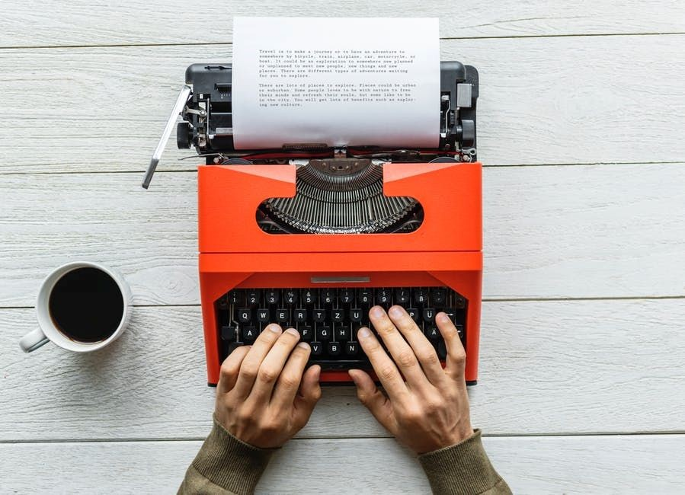

Create news

Slide 4
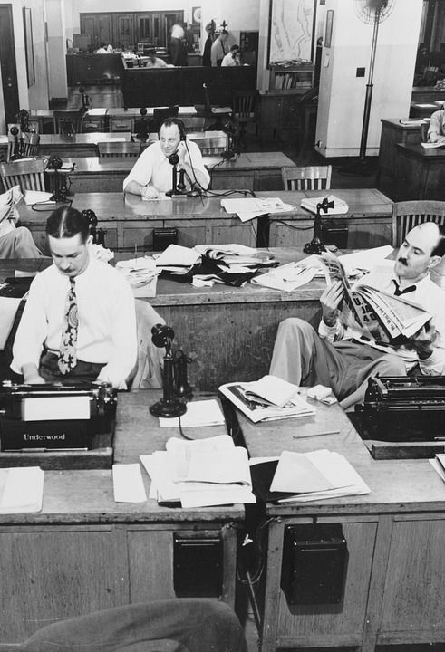
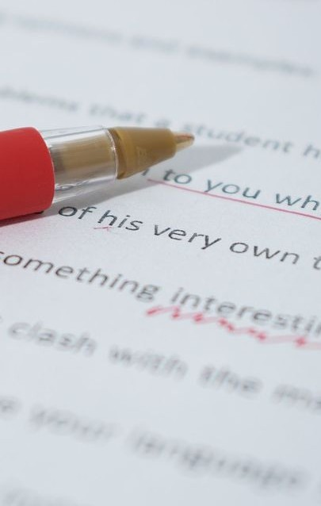

Quality control of news

Slide 5
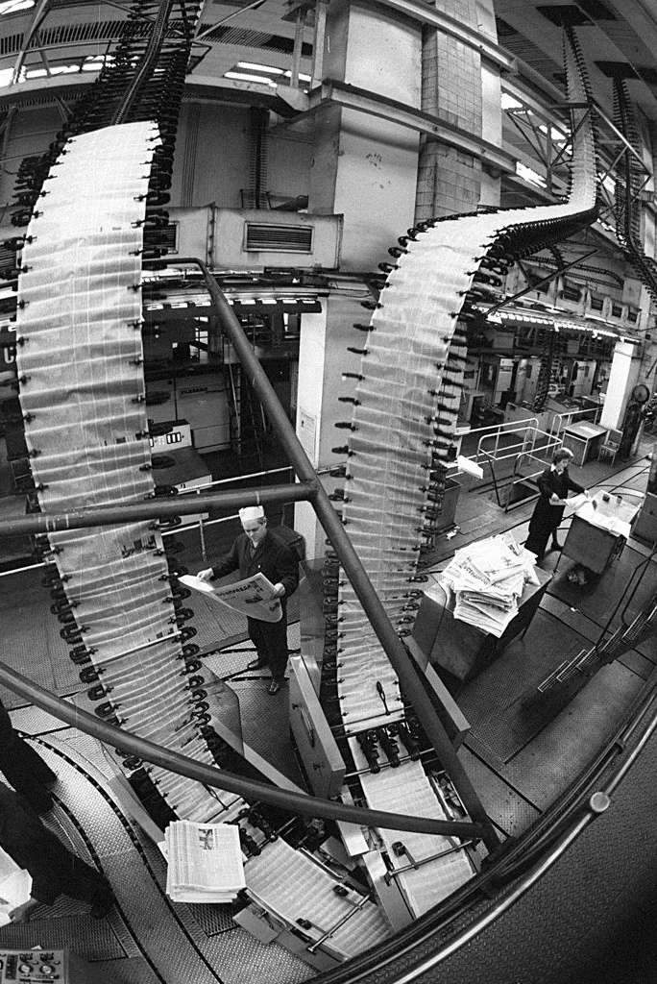
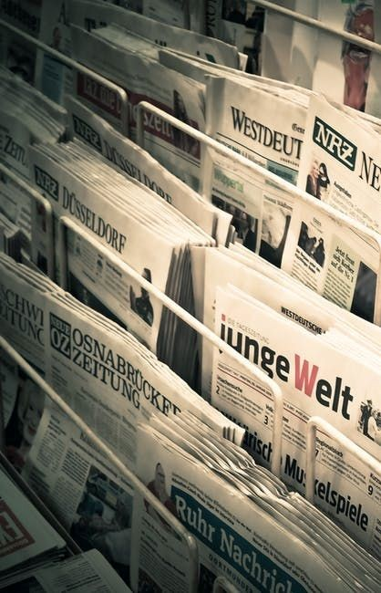

Publication of news

Slide 6


Amplification of news

Slide 7
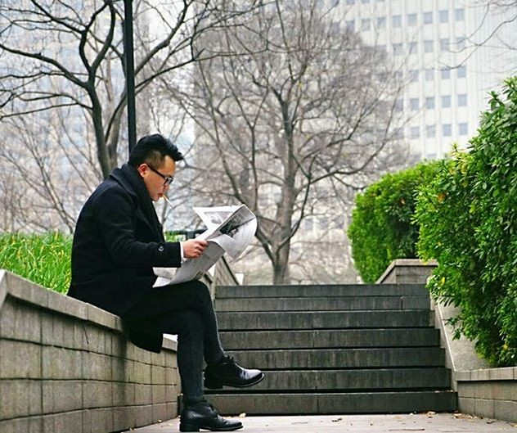

Consumption of news

Slide 8
The news process schematically

Slide 9

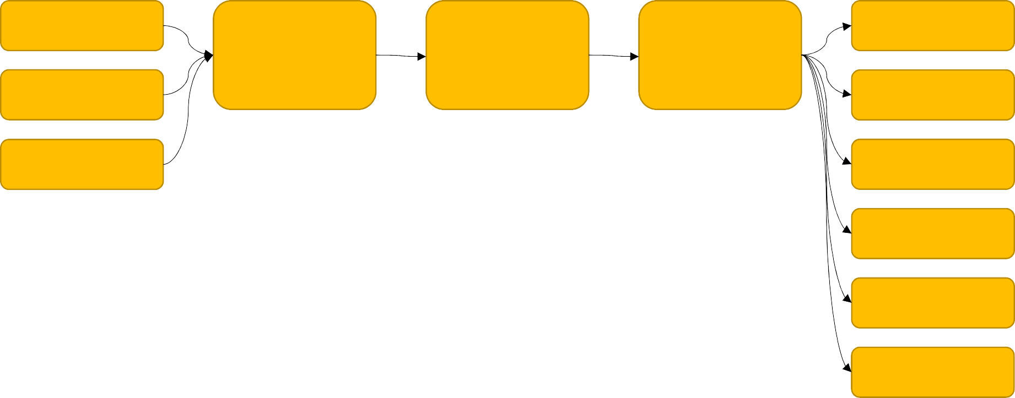


Traditional news process
control
control
create
consume
edit
publish
amplify
create
consume
create professionals
reasonable, responsible, liable publisher
consume
editorial policy
state censorship
consume
consume
self censorship
consume

Slide 10

Enters the Internet
anyone can publish
anyone can amplify
anyone can edit
editors are gone
no trashcan
source: wikipedia

Slide 11



Internet-age news process
?
?
amateurs and professionals
create
consume
create
publish
consume
create
consume
edit
amplify
consume
consume
self censorship
consume

Slide 12
Technology for “fake news” dissemination

Slide 13
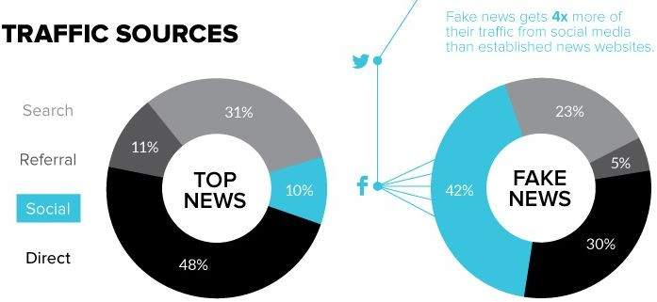
Social media is main driver for “fake news”
10% of readers of top news come via social media
40% of readers of “fake news” come via social media

Slide 14
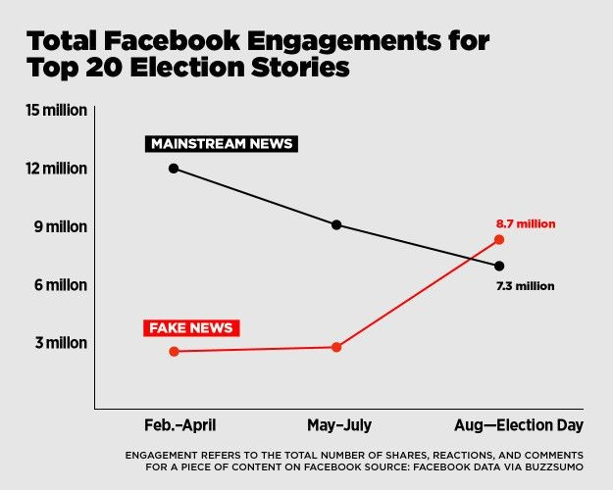
Fake and real news have about the same engagement on social media
this is 10% for real news
but 40% for “fake news”

Slide 15
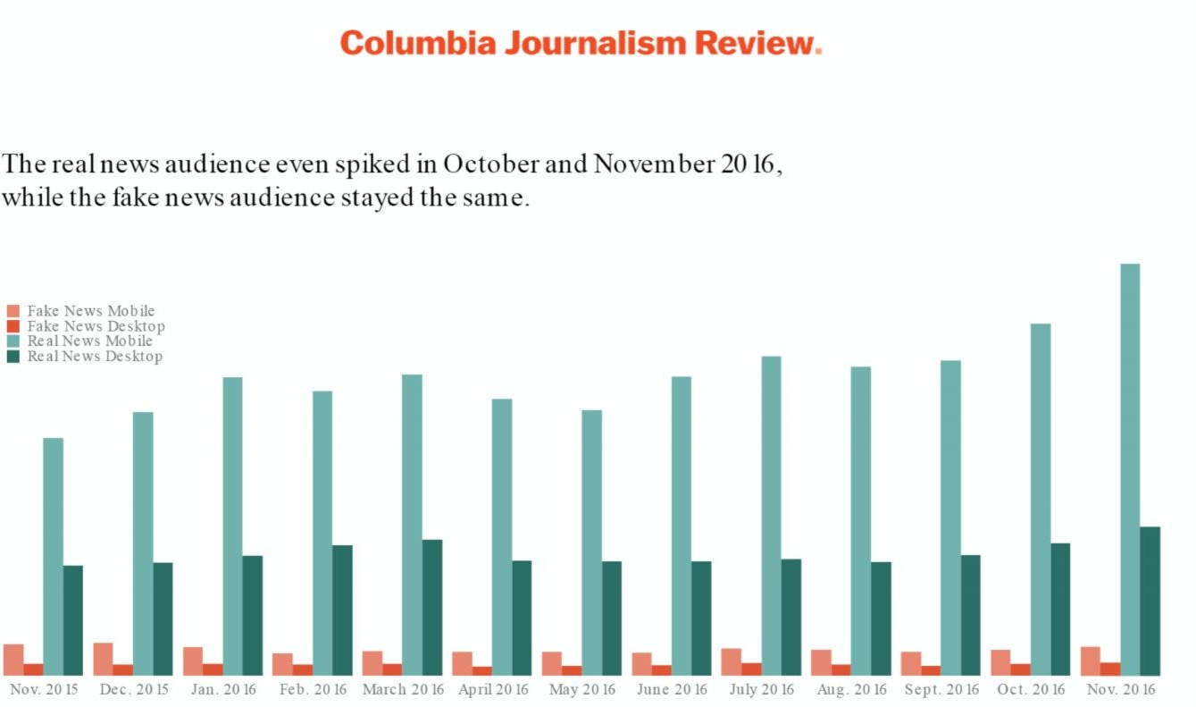
“Fake news” (orange) audience is 10% of real news (green)

Slide 16
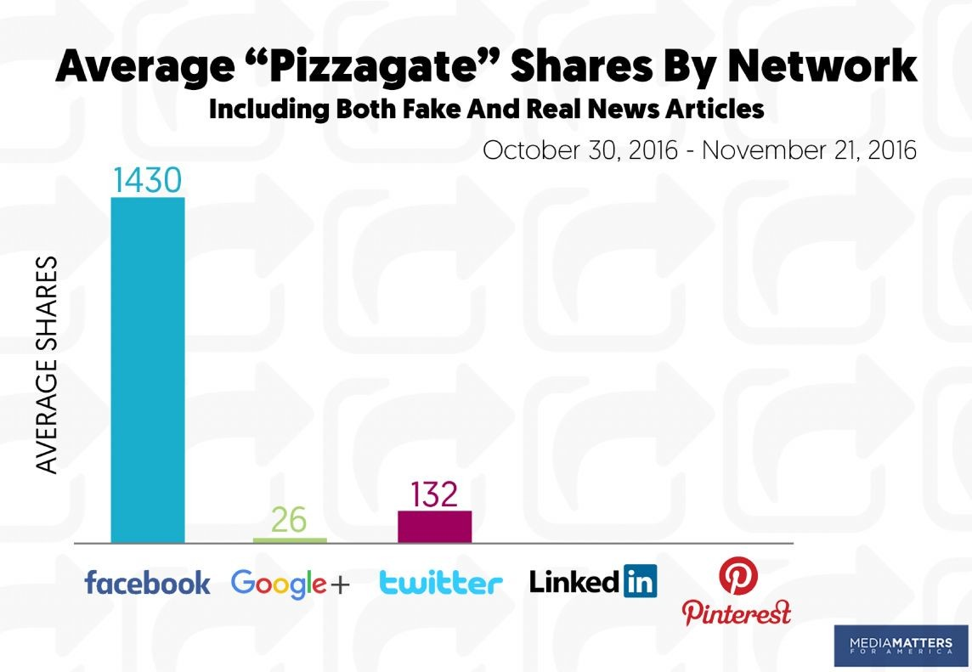
For „fake news“ main source is Facebook

Slide 17
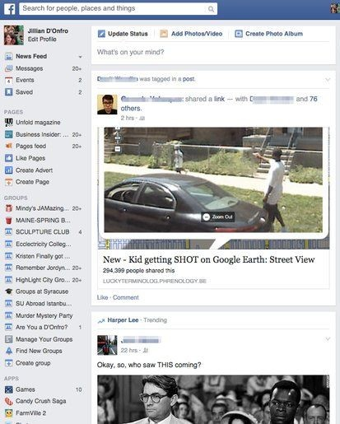
On Facebook users see 10% of what they „subscribe” to
Facebook decides which 10%
Facebook chose to remove news from feed
hurting 10% of real news traffic
hurting 40% of fake news traffic
Both unhappy!

Slide 18
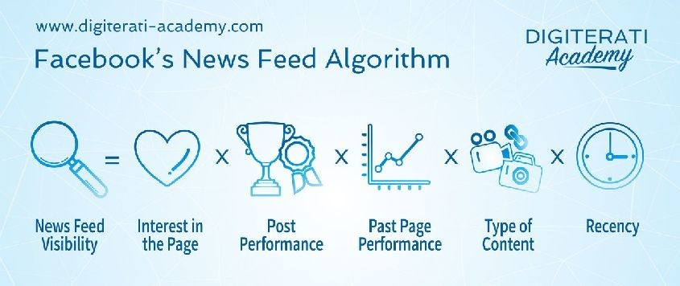
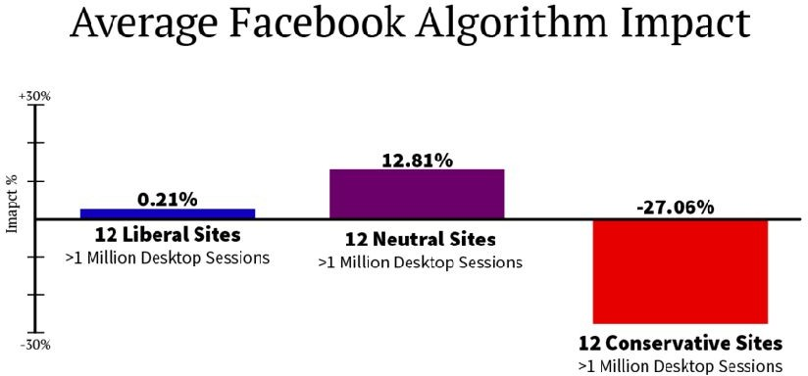
How they choose the 10% is
key issue for stopping “fake news”!
Facebook’s goal: „keep audience at site and engaged“
Algorithm is opaque
Algorithm is changing
Algorithm is unfair?
source: The Western Journal

Slide 19
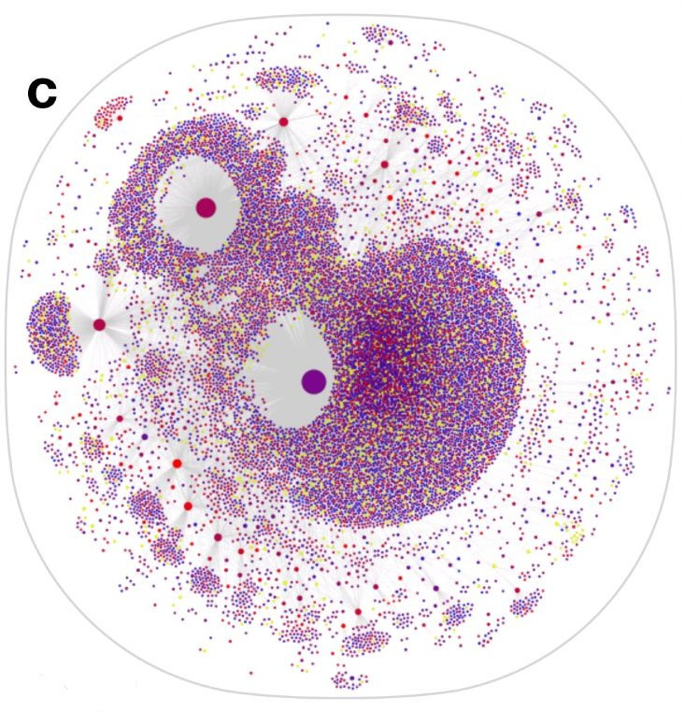
Bots spread fake news on Twitter. And real news.
“We find evidence that social bots play
a disproportionate role in spreading and repeating misinformation.” (source).
“Contrary to conventional wisdom, robots accelerated the spread of true and false news at the same rate, implying that false news spreads more than the truth because humans, not robots, are more likely to spread it” (source)
Propagation of fake news: Nodes and links represent Twitter accounts and retweets of the claim, respectively. Node size indicates account influence, measured by the number of times an account is retweeted. Node color represents bot score, from blue (likely human) to red (likely bot).

Slide 20
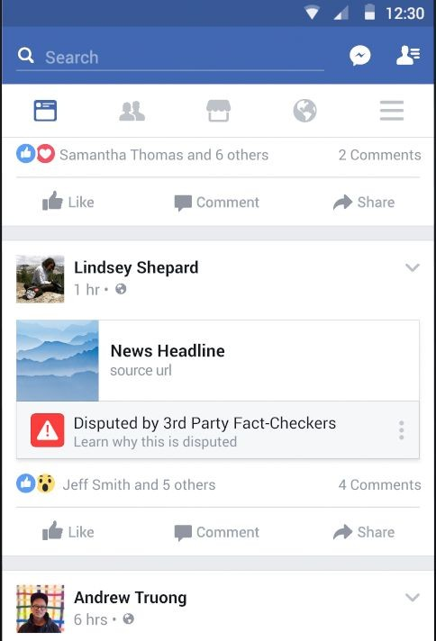
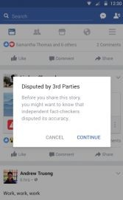

Label „fake news“ on Facebook

Slide 21
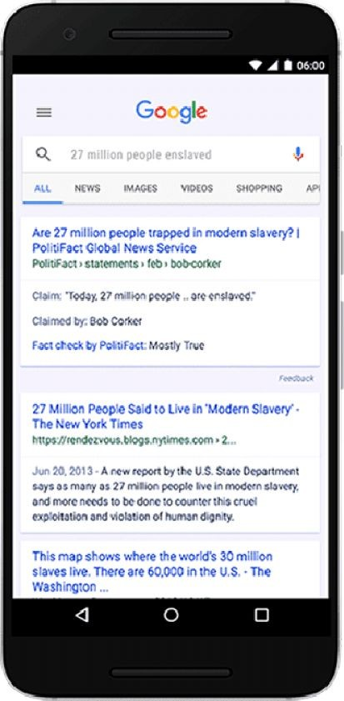
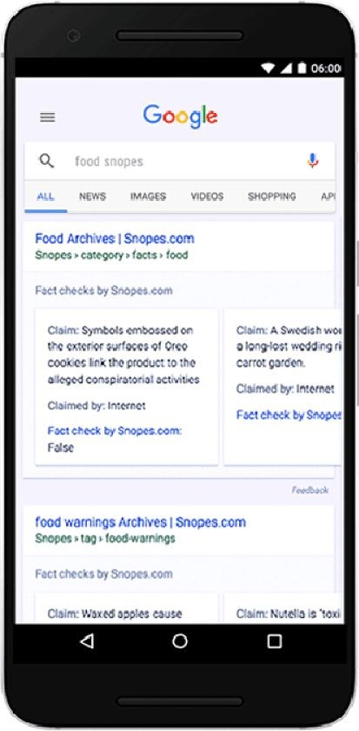


Label “fake news” on Google

Slide 22
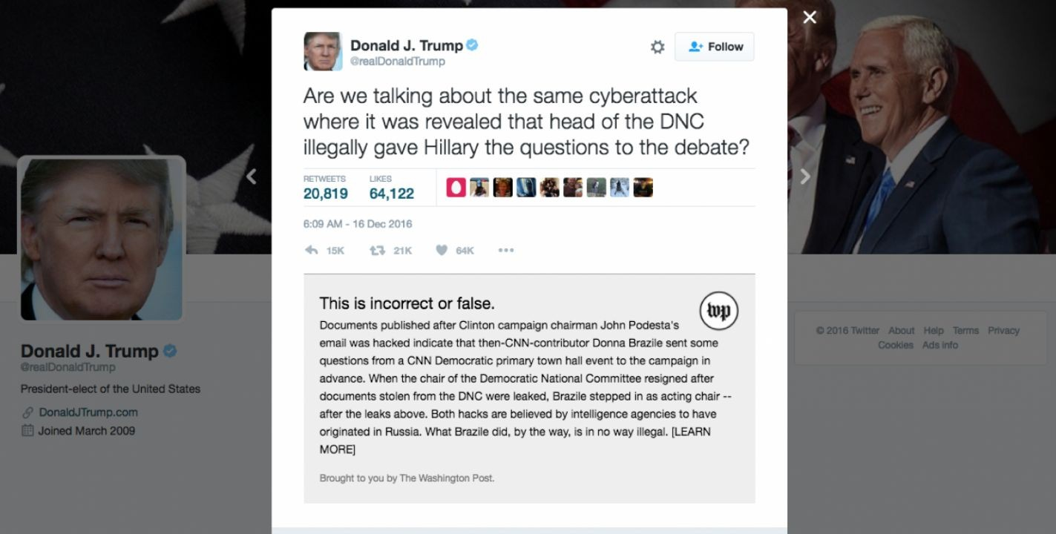
Label “fake news” on Twitter browser

Slide 23
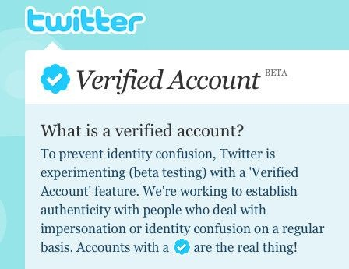

Stop bots!

Slide 24
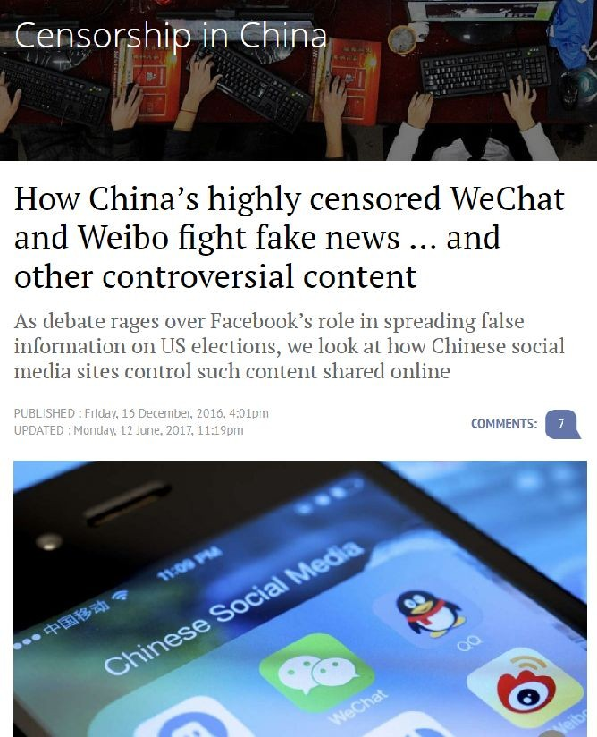
Stopping “fake news” in private chat, email – the next frontier
What’s Up
Facebook Chat
Snapchat
Gmail
Signal
Telegram
Viber
can be done, but!?

Slide 25
Key element: how to identify “fake news”?

Slide 26
Fake news can be identified by humans, machines or combination
Human
human work by fact checkers
fact-checking industry appearing, looking for business model
Human-machine teamwork
machine identifies potentially fake stories
double-checked by human
Machine only
artificial intelligence

Slide 27
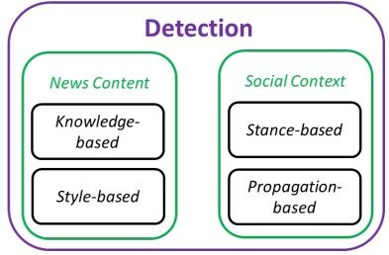
Two strategies for automatic identification of “fake news”
From content
facts
style
From social
stance
propagation
Shu, Kai, Amy Sliva, Suhang Wang, Jiliang Tang, and Huan Liu. "Fake news detection on social media: A data mining perspective." ACM SIGKDD Explorations Newsletter 19, no. 1 (2017): 22-36.

Slide 28
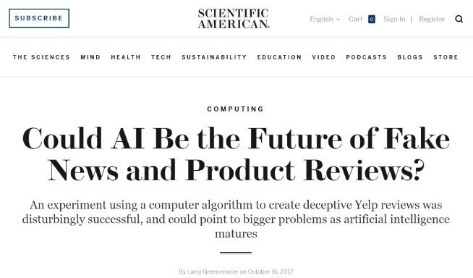

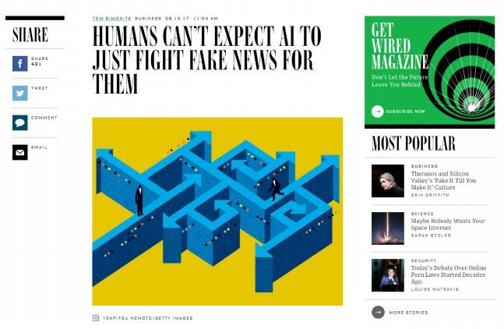
Artificial Intelligence can help. But “Computer did it” is a fallacy

Slide 29
Stop at consumption

Slide 30
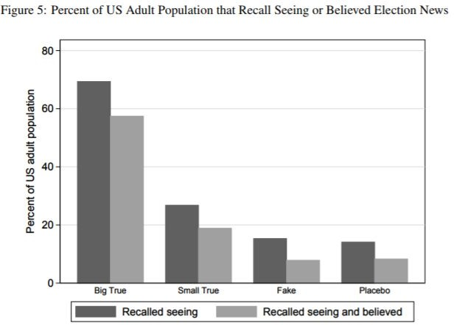
Media literate user is the last and best line of defense
people remember and believe “fake news” about as much as placebo news (non existent news)
“Available evidence suggests that for now the influence of fake news is limited”.
Hunt Allcott & Matthew Gentzkow, 2017. "Social Media and Fake News in the 2016 Election," Journal of Economic Perspectives, vol 31(2), pages 211-236.

Slide 31
Conclusions

Slide 32
Yes we can. But may we?
gatekeepers are gone
only guerrilla war on fake news is possible
technology to disturb circulation of fake news exists
most efficient if platforms cooperate
some approaches are clearly interfering with free speech
users seem to be quite capable at identifying fake news
to early to blame election results on fake news

